Slide 1
Python Bottle Web Application
Karol Rochalski

Slide 2
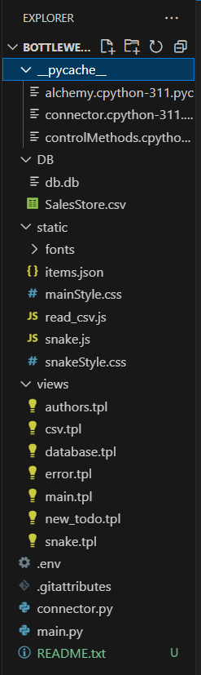
Project structure
The application follows basic structure of Bottle web framewoek which is very similar to flask architecture. It uses standard structure of address requests controlled by main.py file, then leading to different templates or custom output. The templates allow to access static or dynamic resources.

Slide 3
The main page
It contains links to all other webpages. The app runs on default port 8080.

Slide 4
The CSVReader
It allows to quickly load and read CSV file in the area of webpage. The page is coded statically due to unresolved header error and can process only one CSV file.

Slide 5
Local SQL Database
The SQL database implements TODO list generated sqlite database file. The webpage can accept new inputs and might be effectively used to delete certain values with POST method.

Slide 6
A custom error page
The Bottle framework allows to adjust custom error pages to differ from standard negative 404 output. The project got enriched with application.

Slide 7
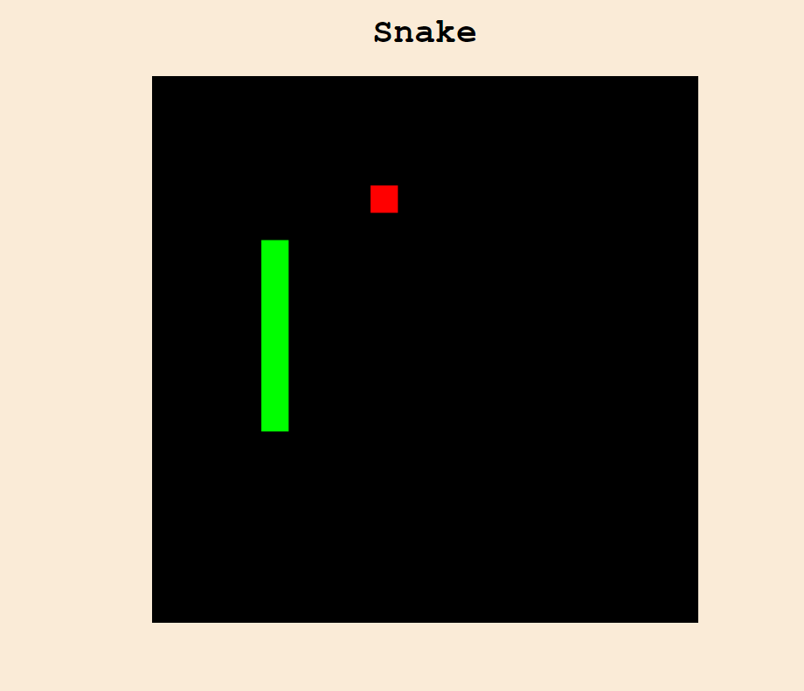
Snake game
As a bonus a simple
snake game is developed
as a result of extra time.

Slide 8
Voilà! C’est la fin!
Thanks for checking my project.
Best Regards, Karol Rochalski

